Slide 1

GROUP- 3
HOSPITAL MANAGEMENT SYSTEM

Slide 2
Team- 3
Gaurav Mishra 2530044
Gurmeet Singh 2528999
Hrithik Bandil 2528487
Imadabathuni Ramya Datha 2526239
Jyothiradithya Ravula 2528920
K Prashanth Reddy 2526908
K S Murali 2527218
K S Sudeshna 2529602
Kabilan C 2528017
Kannan X 2530129

Slide 3
Hospital Management System
Hospital Management System is easy to use and eliminates errors caused by handwriting.
It provides all data in a single platform, hence enables Business Intelligence Module to provide valuable insights into hospital operations and the quality of patient care.
It enhances the overall health care experience in a healthcare facility.
It improves the communication and interaction of doctors with their patients.
It reduces expenses of an organization because of less paperwork, improved safety, and reduced duplication of testing.

Slide 4
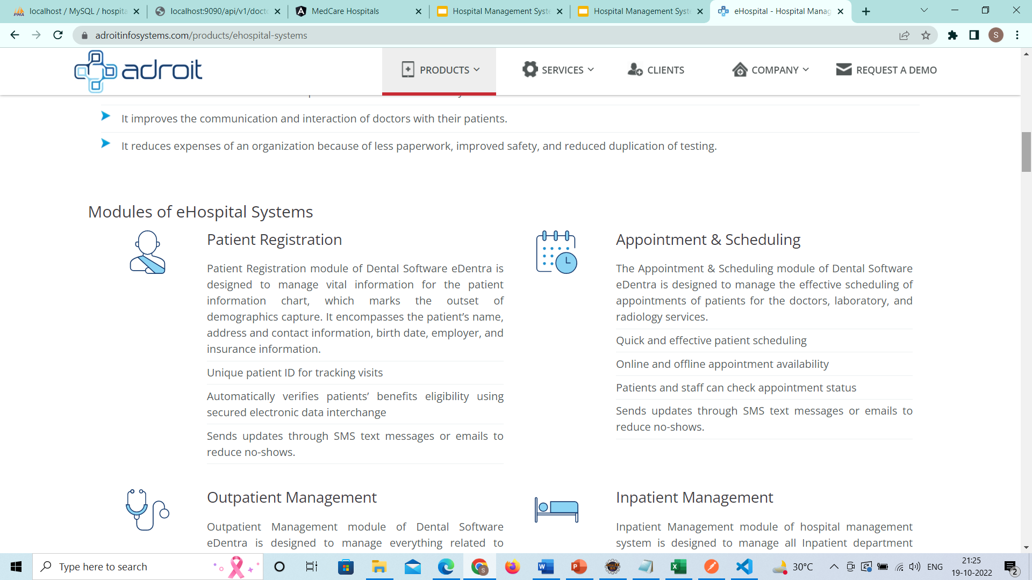
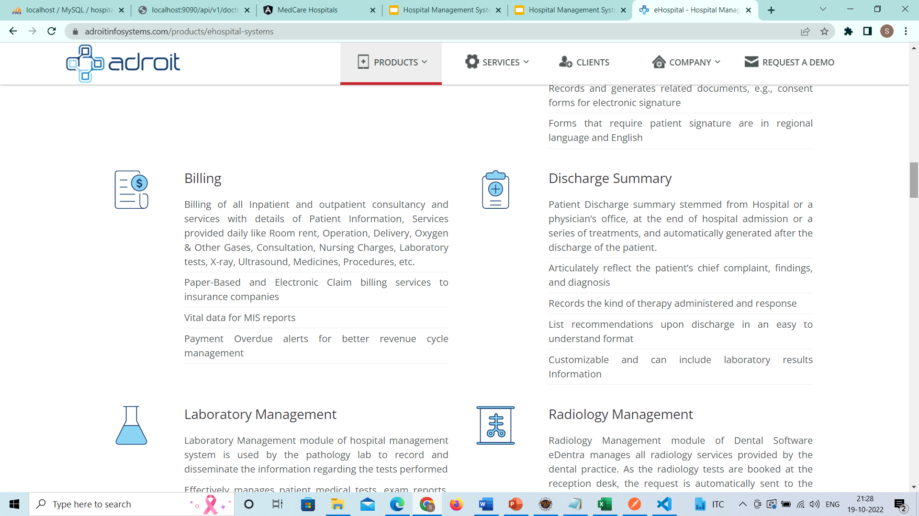
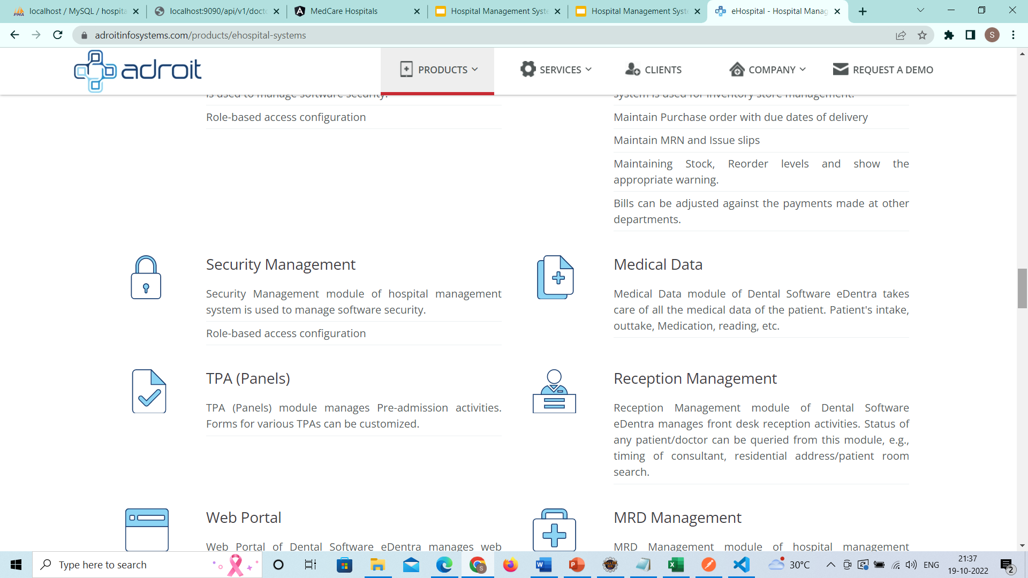
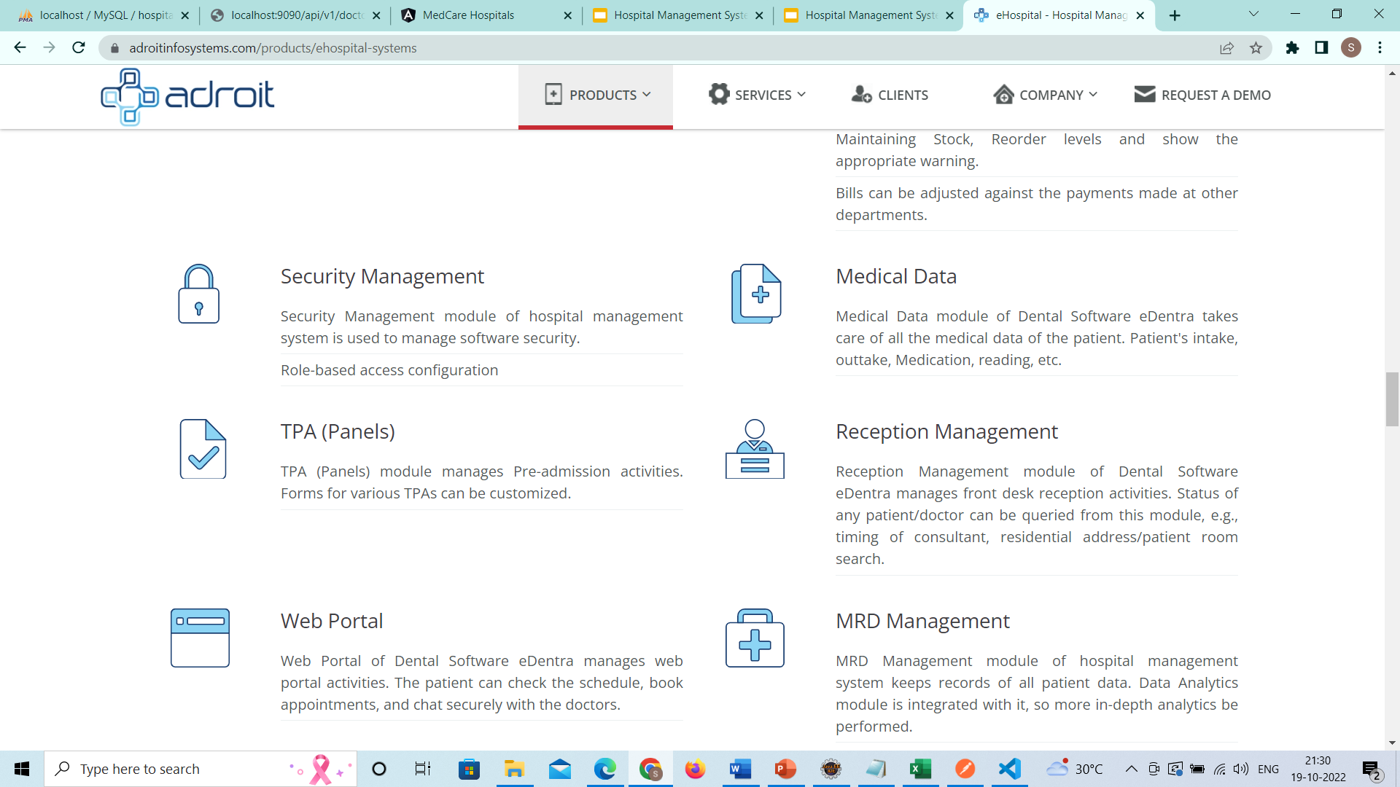
Features of MedCare Hospitals HMS
Patient Data Management
Doctor Data Management
Appointment
Booking
Invoice Details Management
Administrative
Operations
Medical Data

Slide 5
Module 1
Homepage, Login, Dashboard

Slide 6
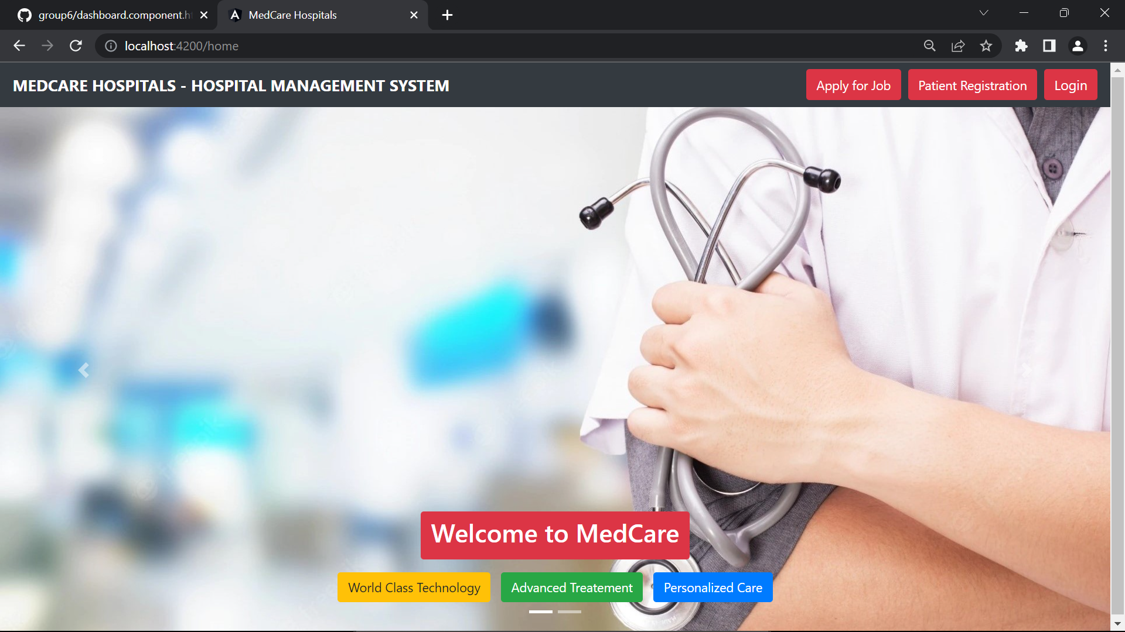
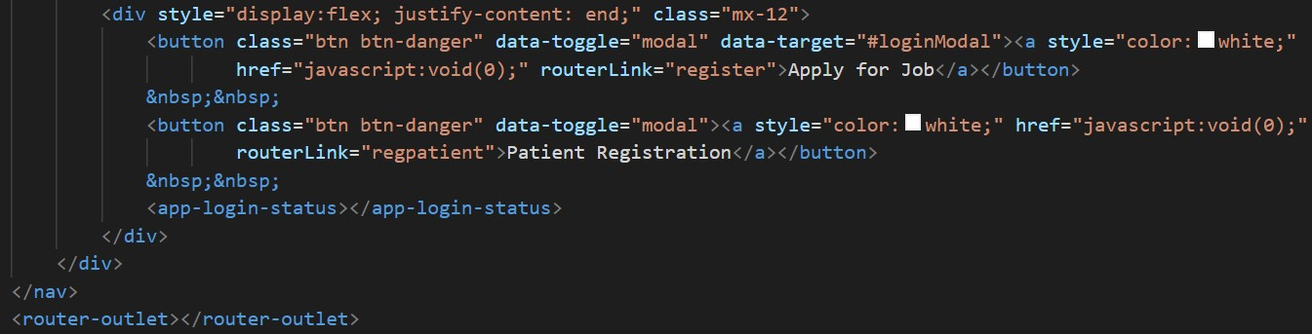
Home → localhost:4200:/home
← Selector

Slide 7
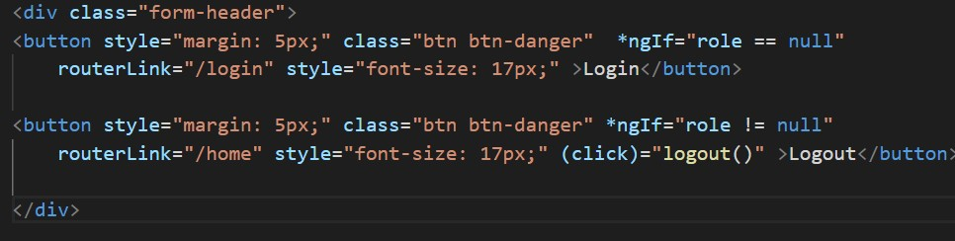
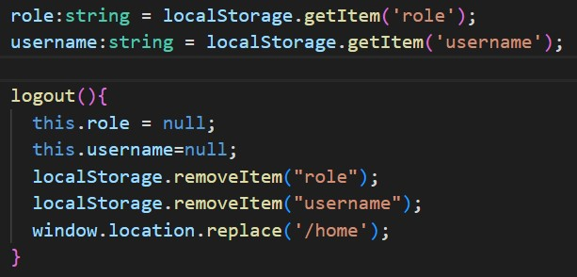
Component : login-status
← Selector

Slide 8
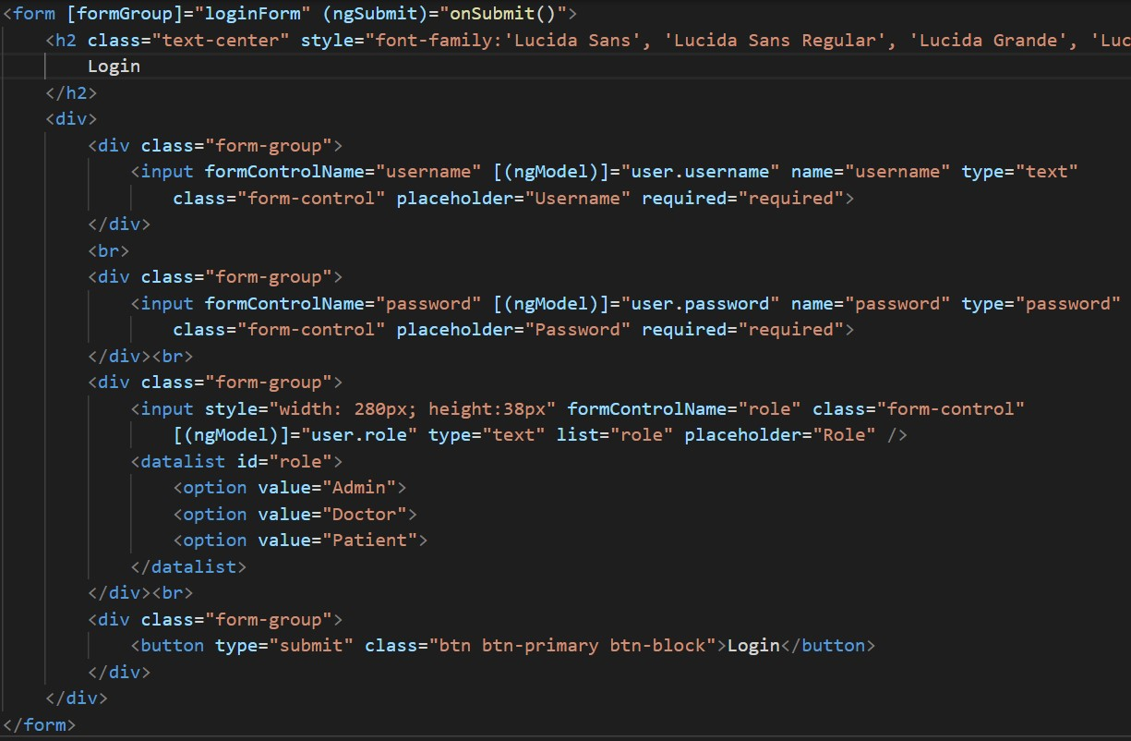
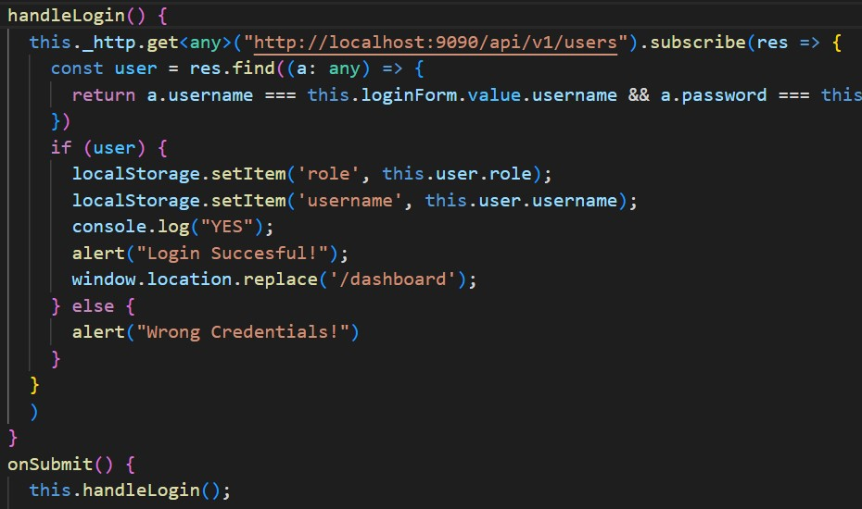
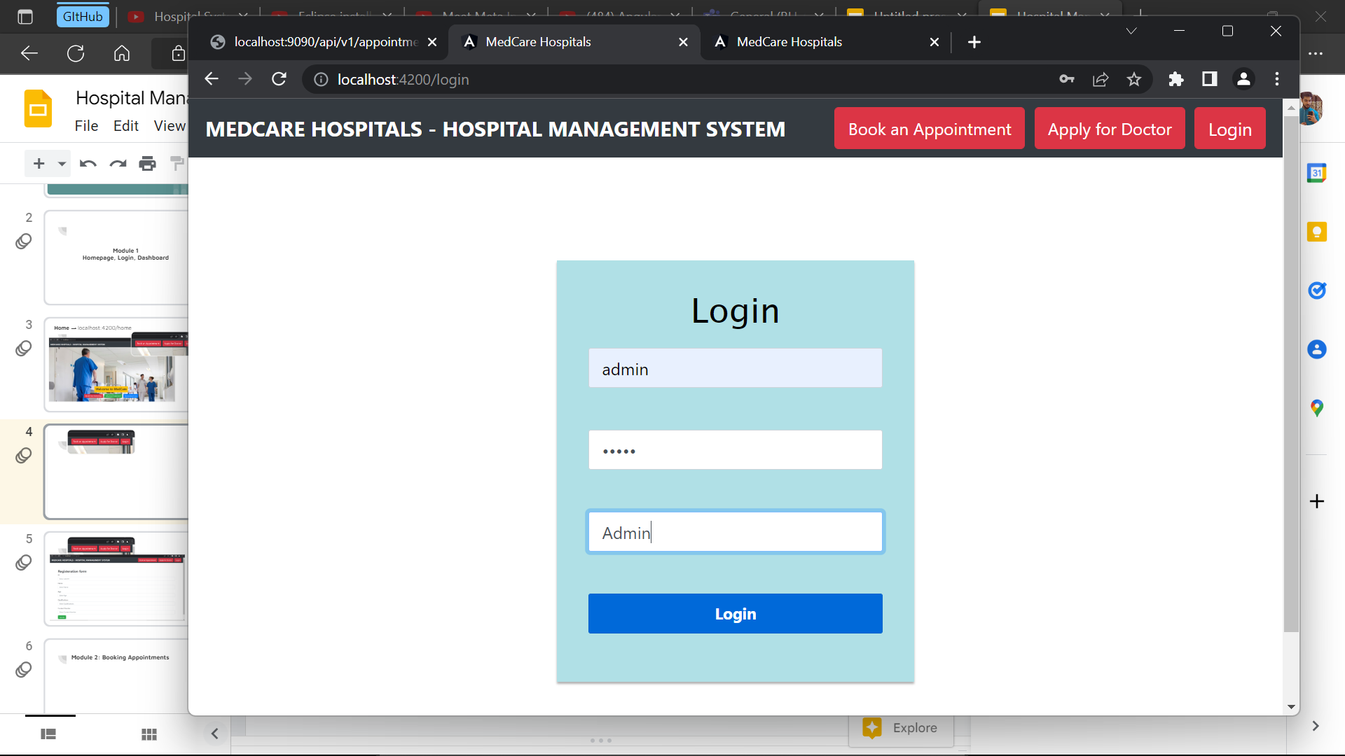
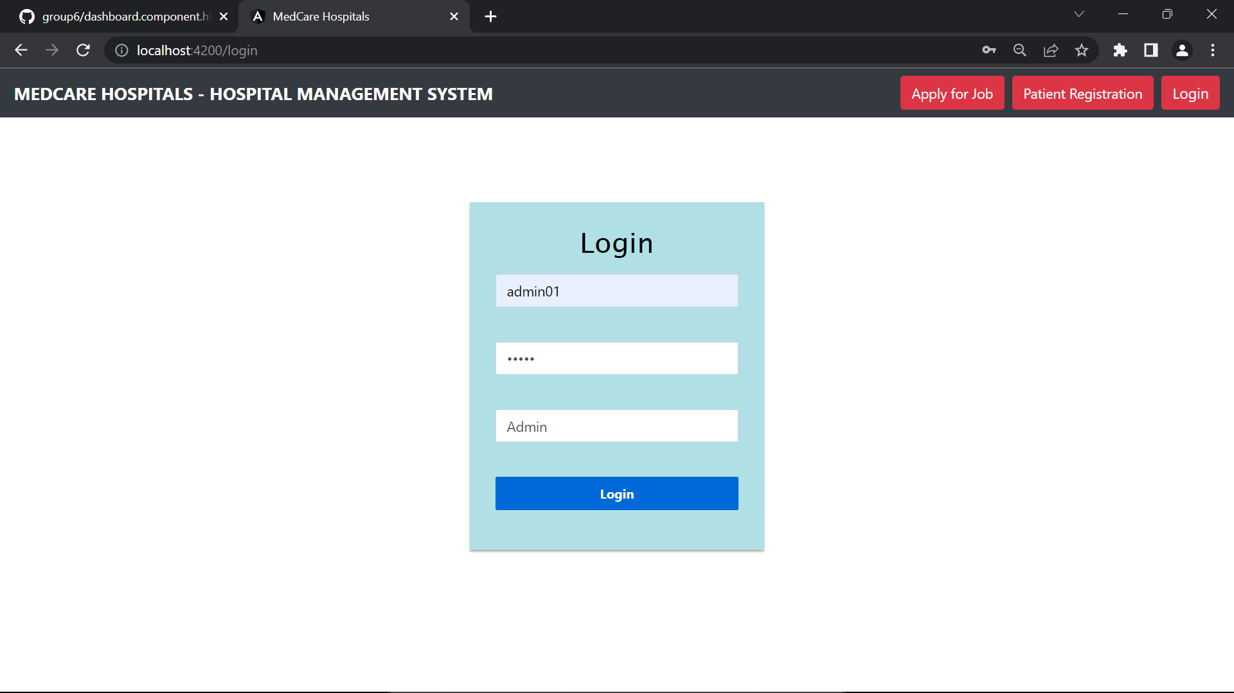
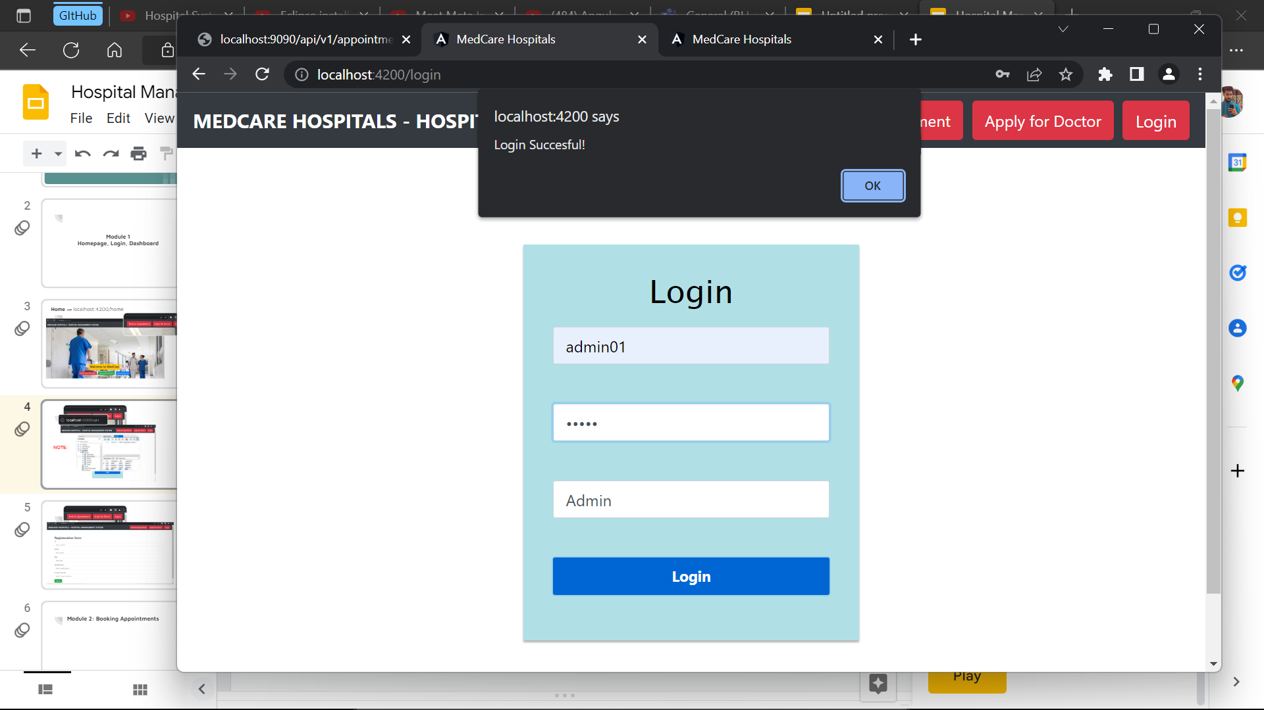

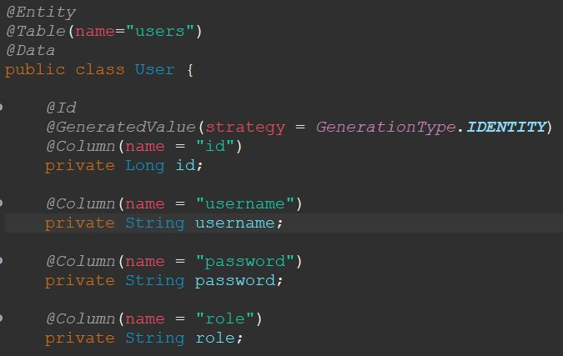
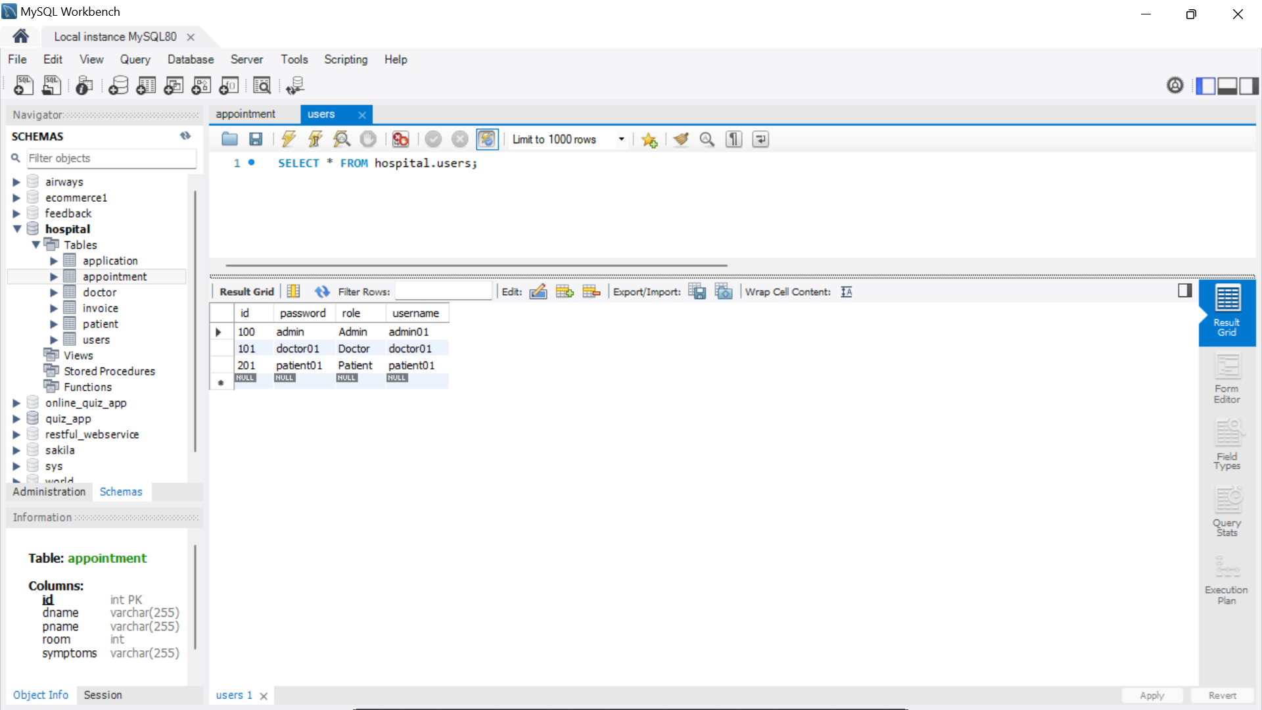
Login → localhost:4200/login
NOTE:

Slide 9
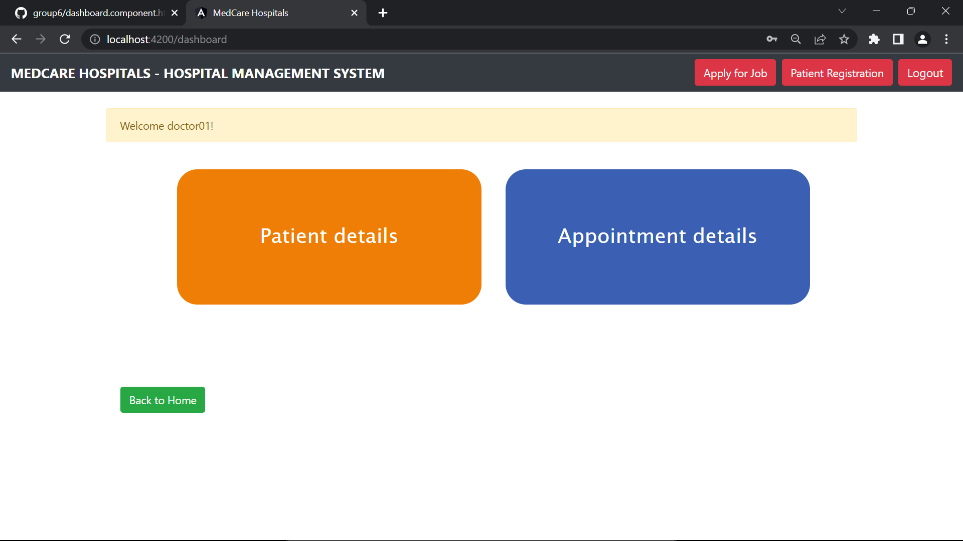
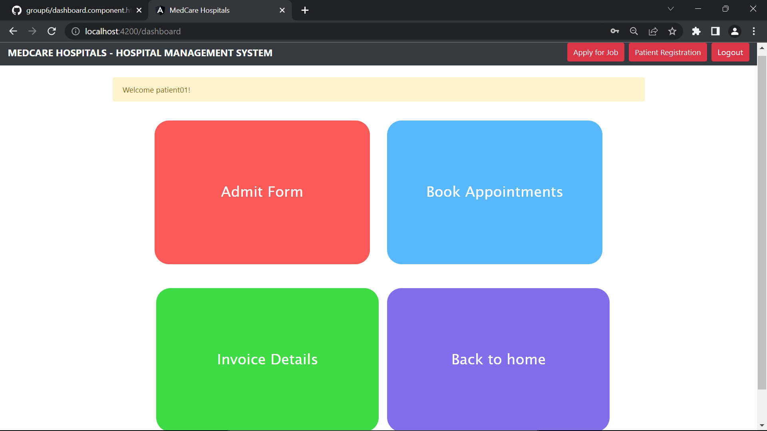

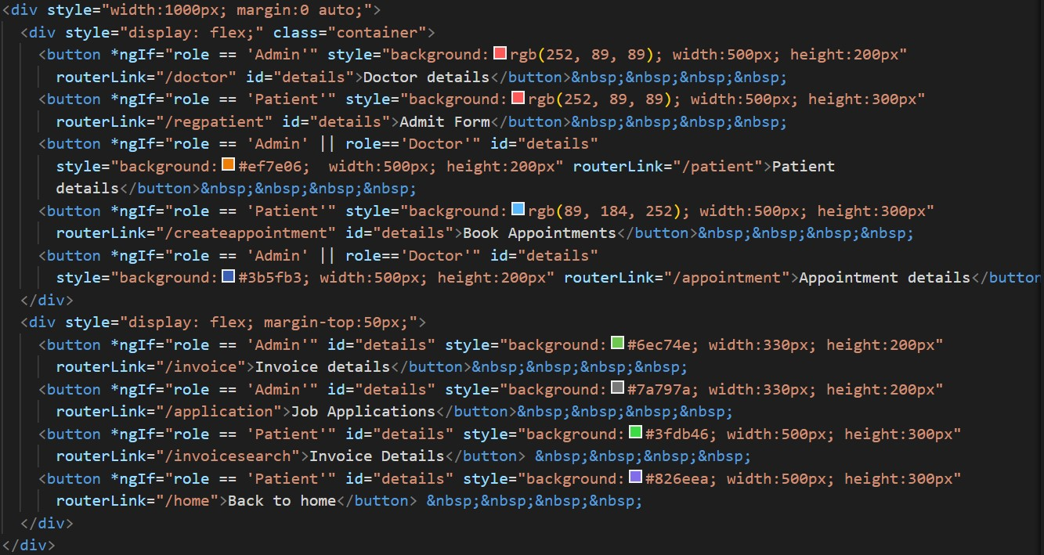

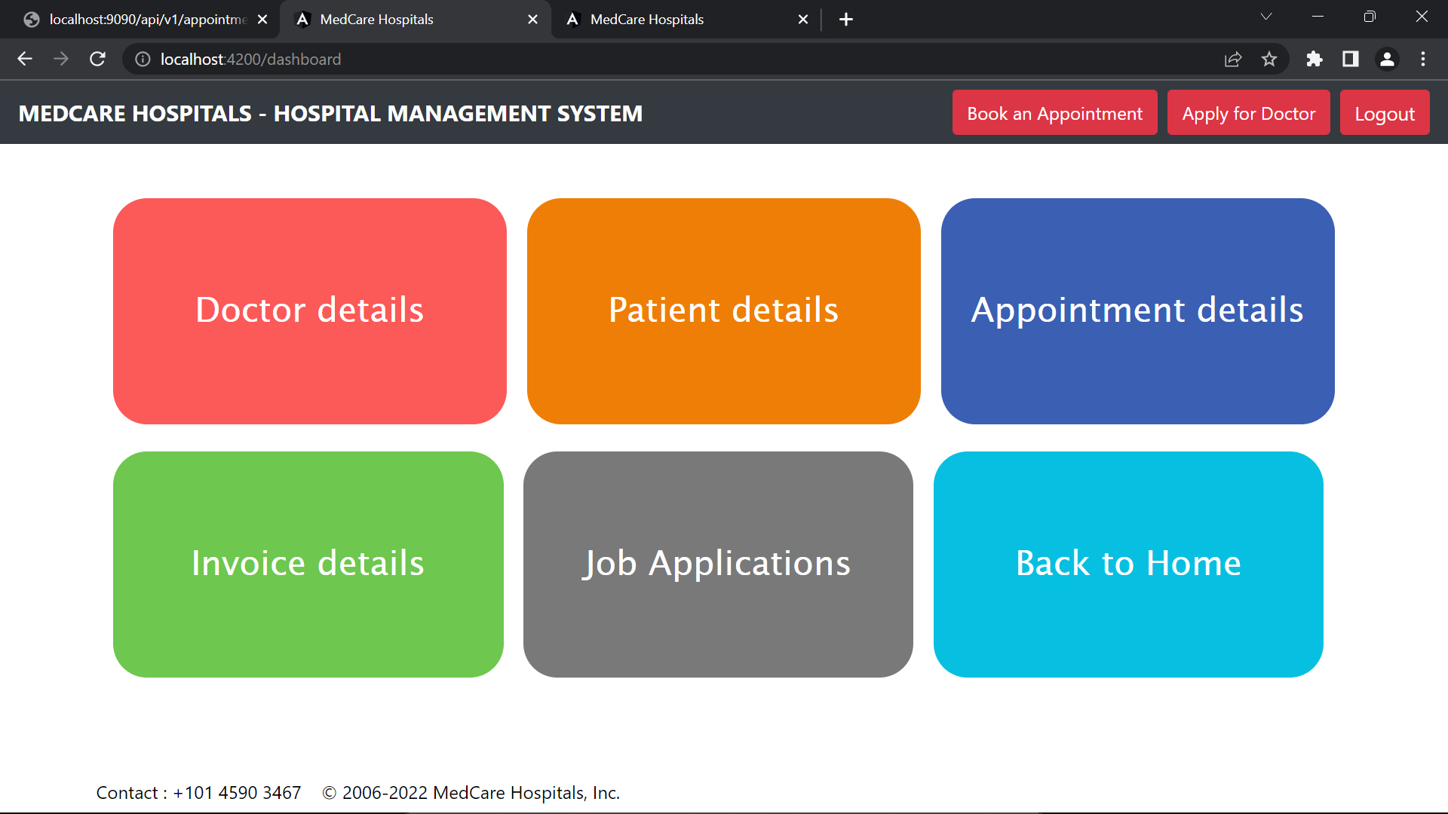
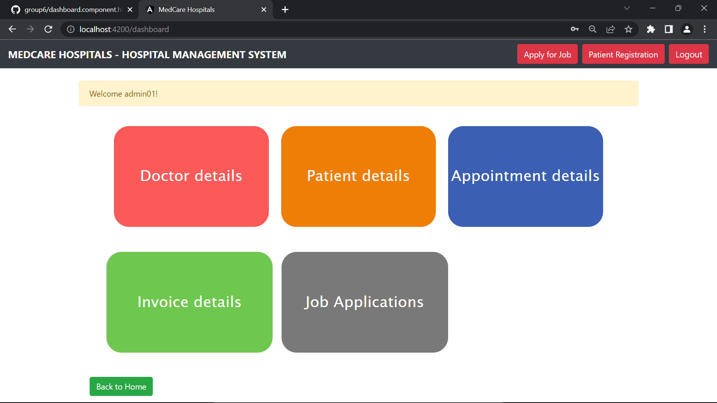
DASHBOARD → localhost:4200/dashboard

Slide 10
Module 1
—-Ends—-

Slide 11
Module 2
Job Application

Slide 12
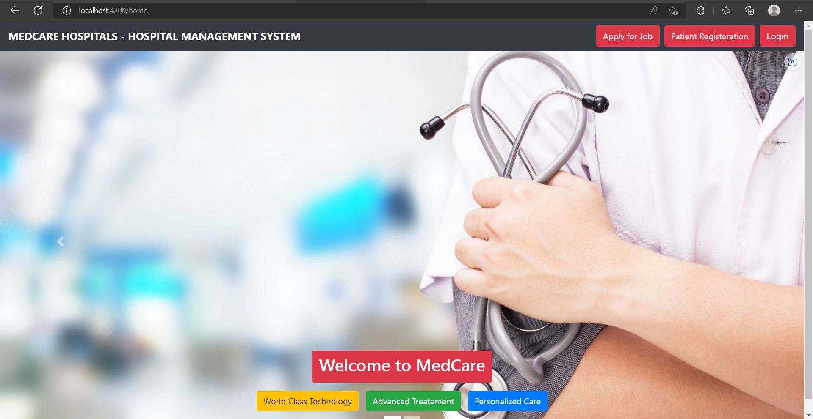
→ Go to Homepage (localhost:4200).
→ Click on “Apply for job”.

Slide 13
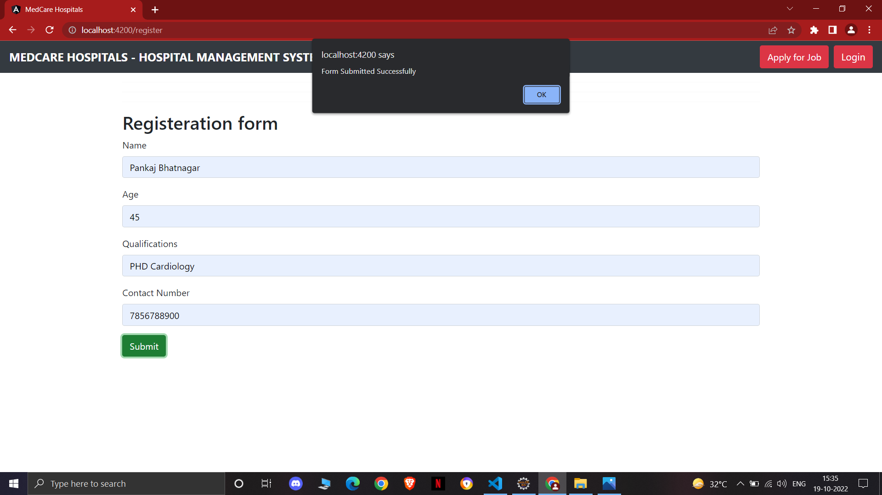
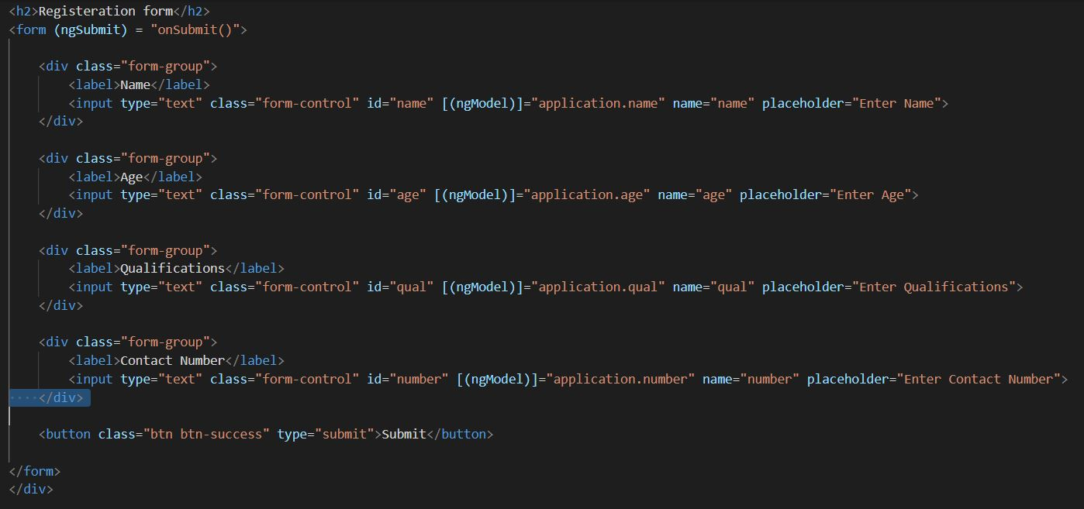
Fill out the mandatory details in the form and click on submit.
You will be prompted if the form submitted successfully.

Slide 14
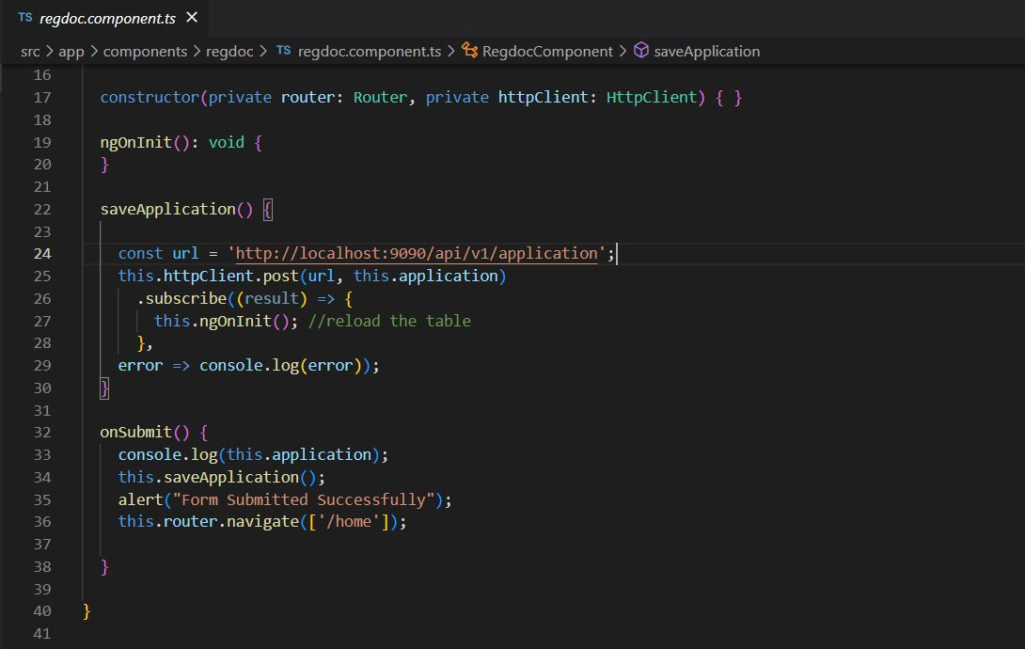
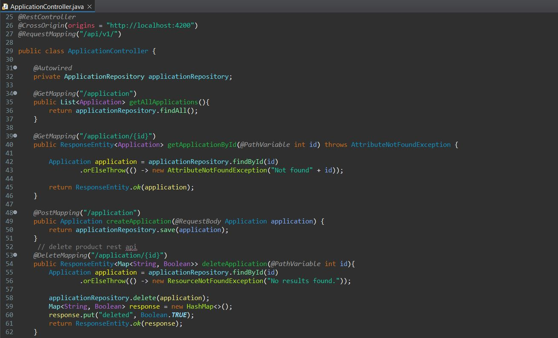
Onsubmit() and Application Controller to create an application.

Slide 15

Another application..

Slide 16
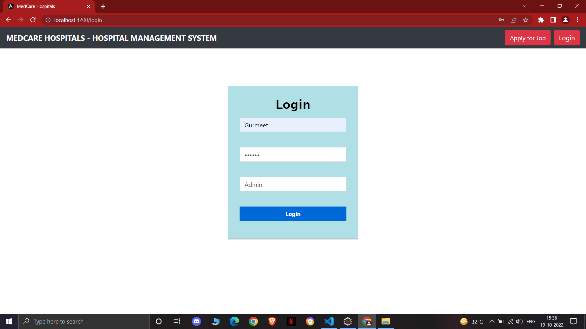
Admin can login from home page to check the applications.

Slide 17
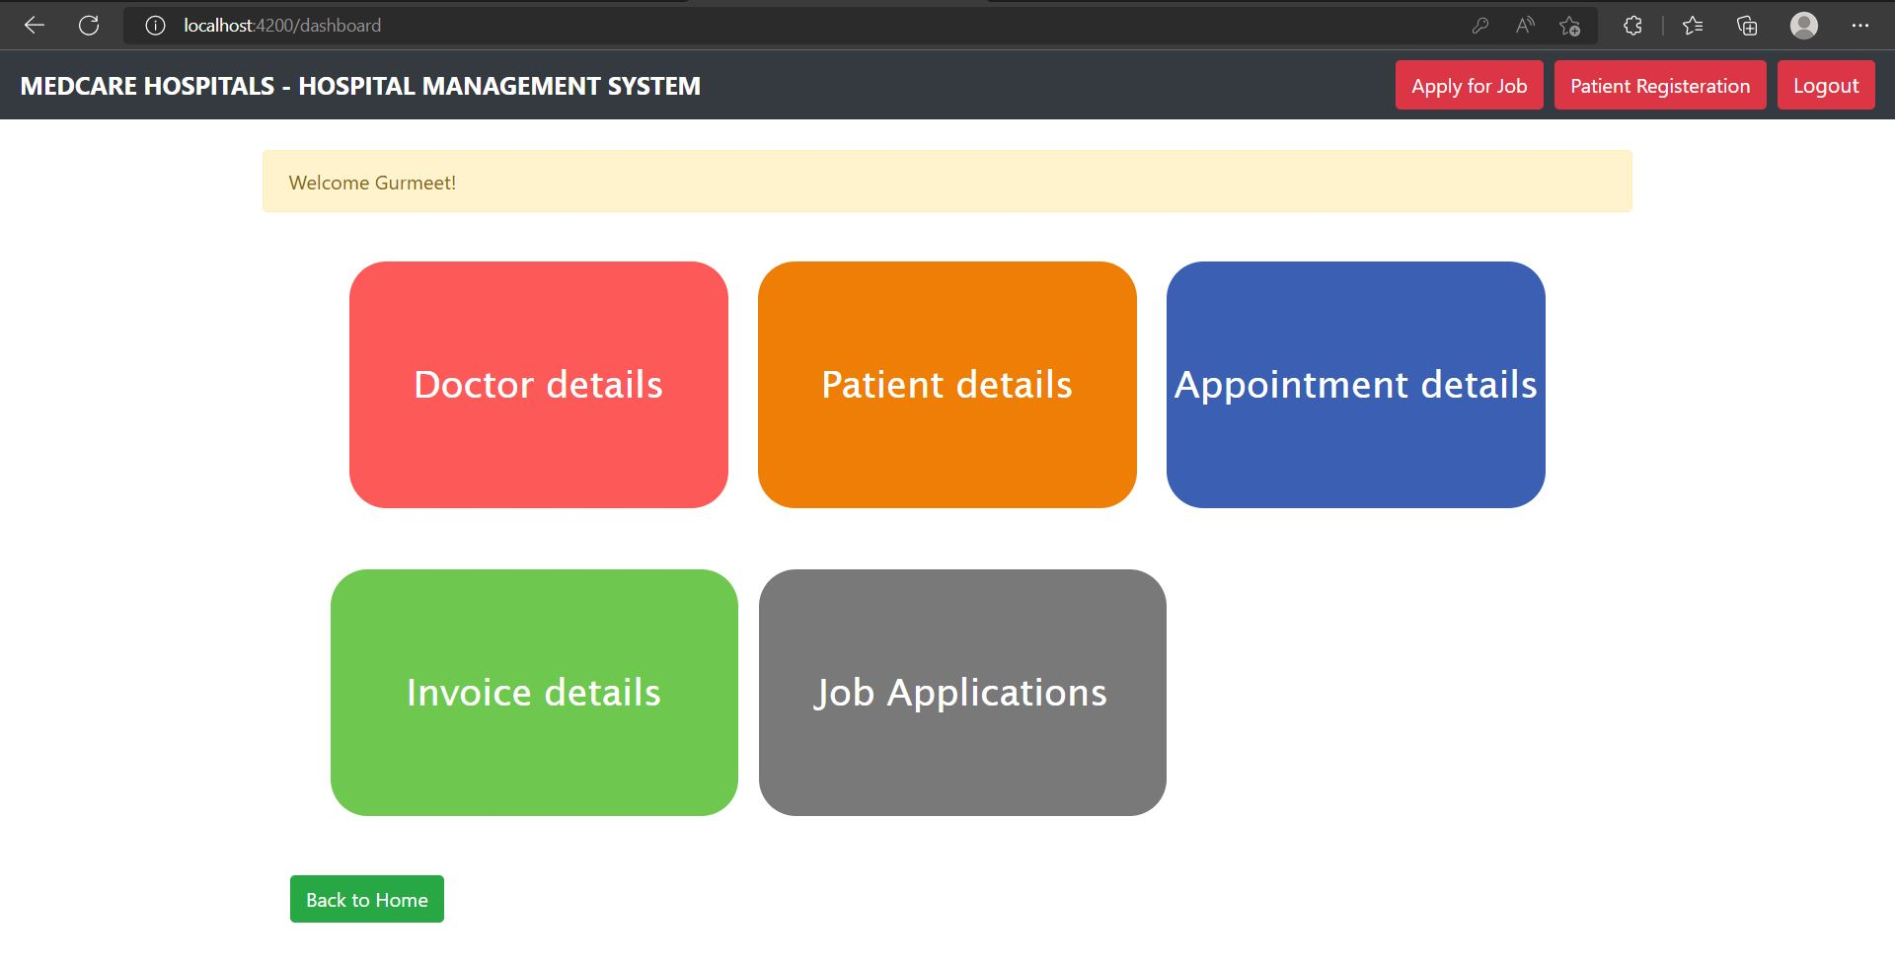
Click on Job Applications to Check all the applications.

Slide 18
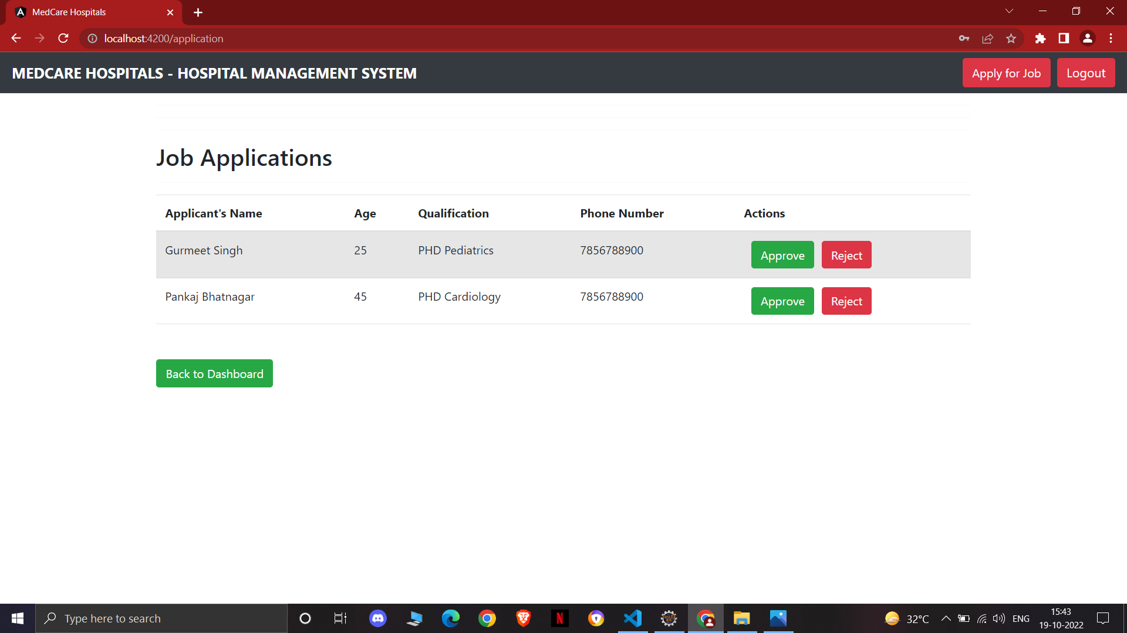
You can see all the job applications.

Slide 19
Module 3
Doctor CRUD

Slide 20
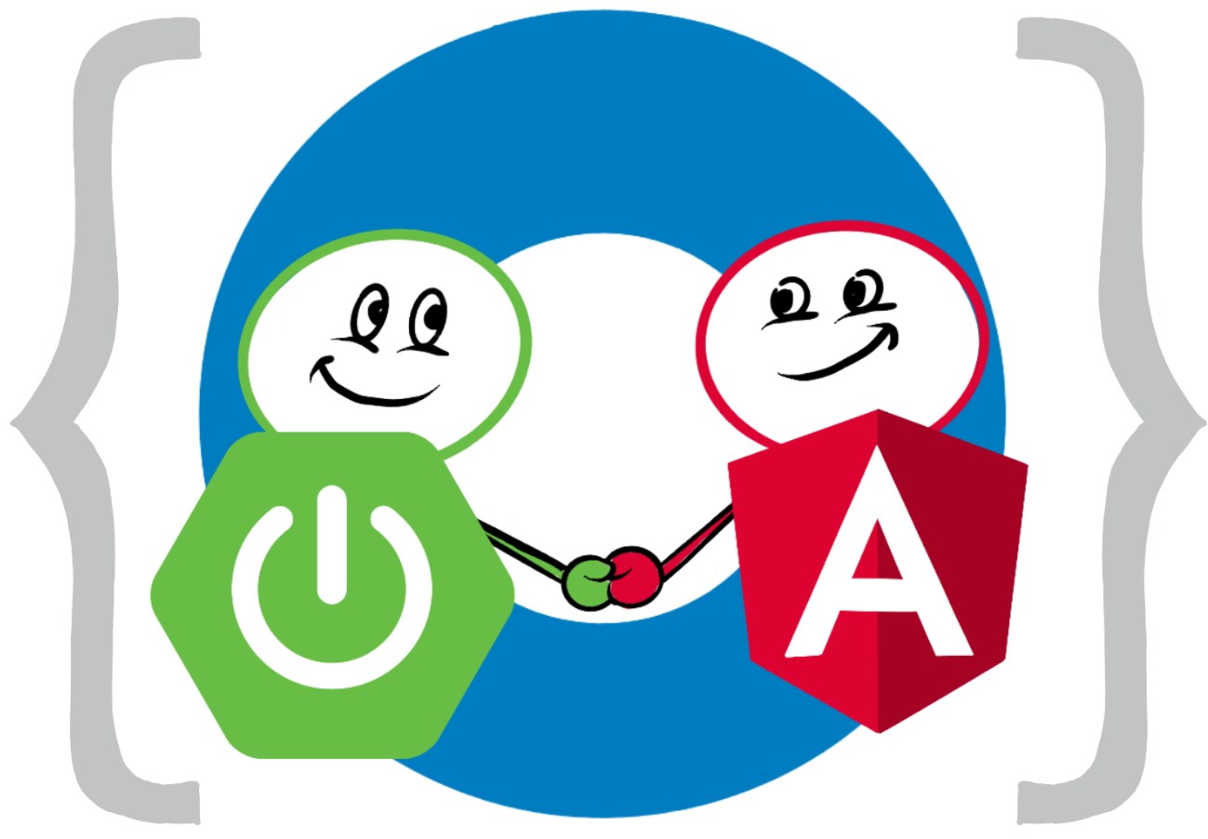
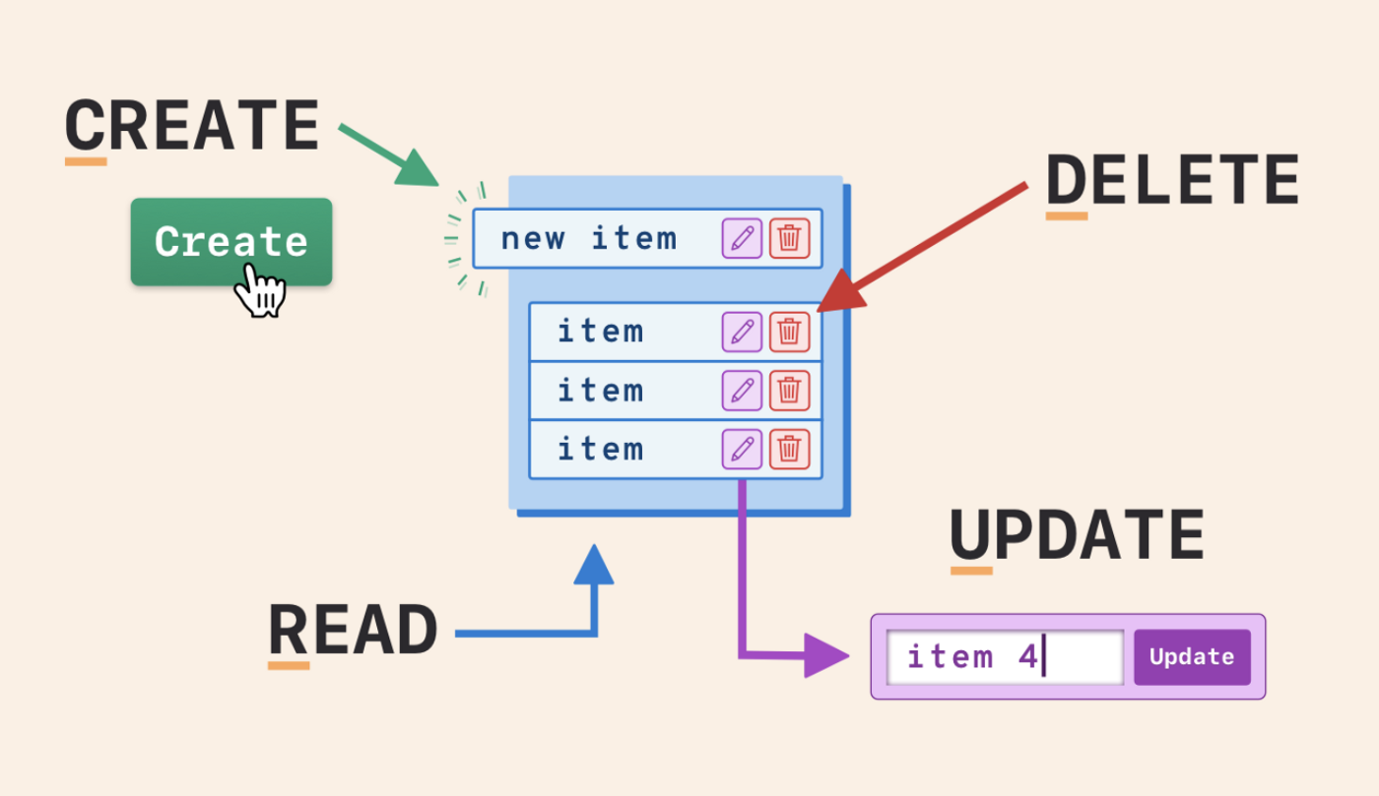

Module 3: Doctor CRUD

Slide 21
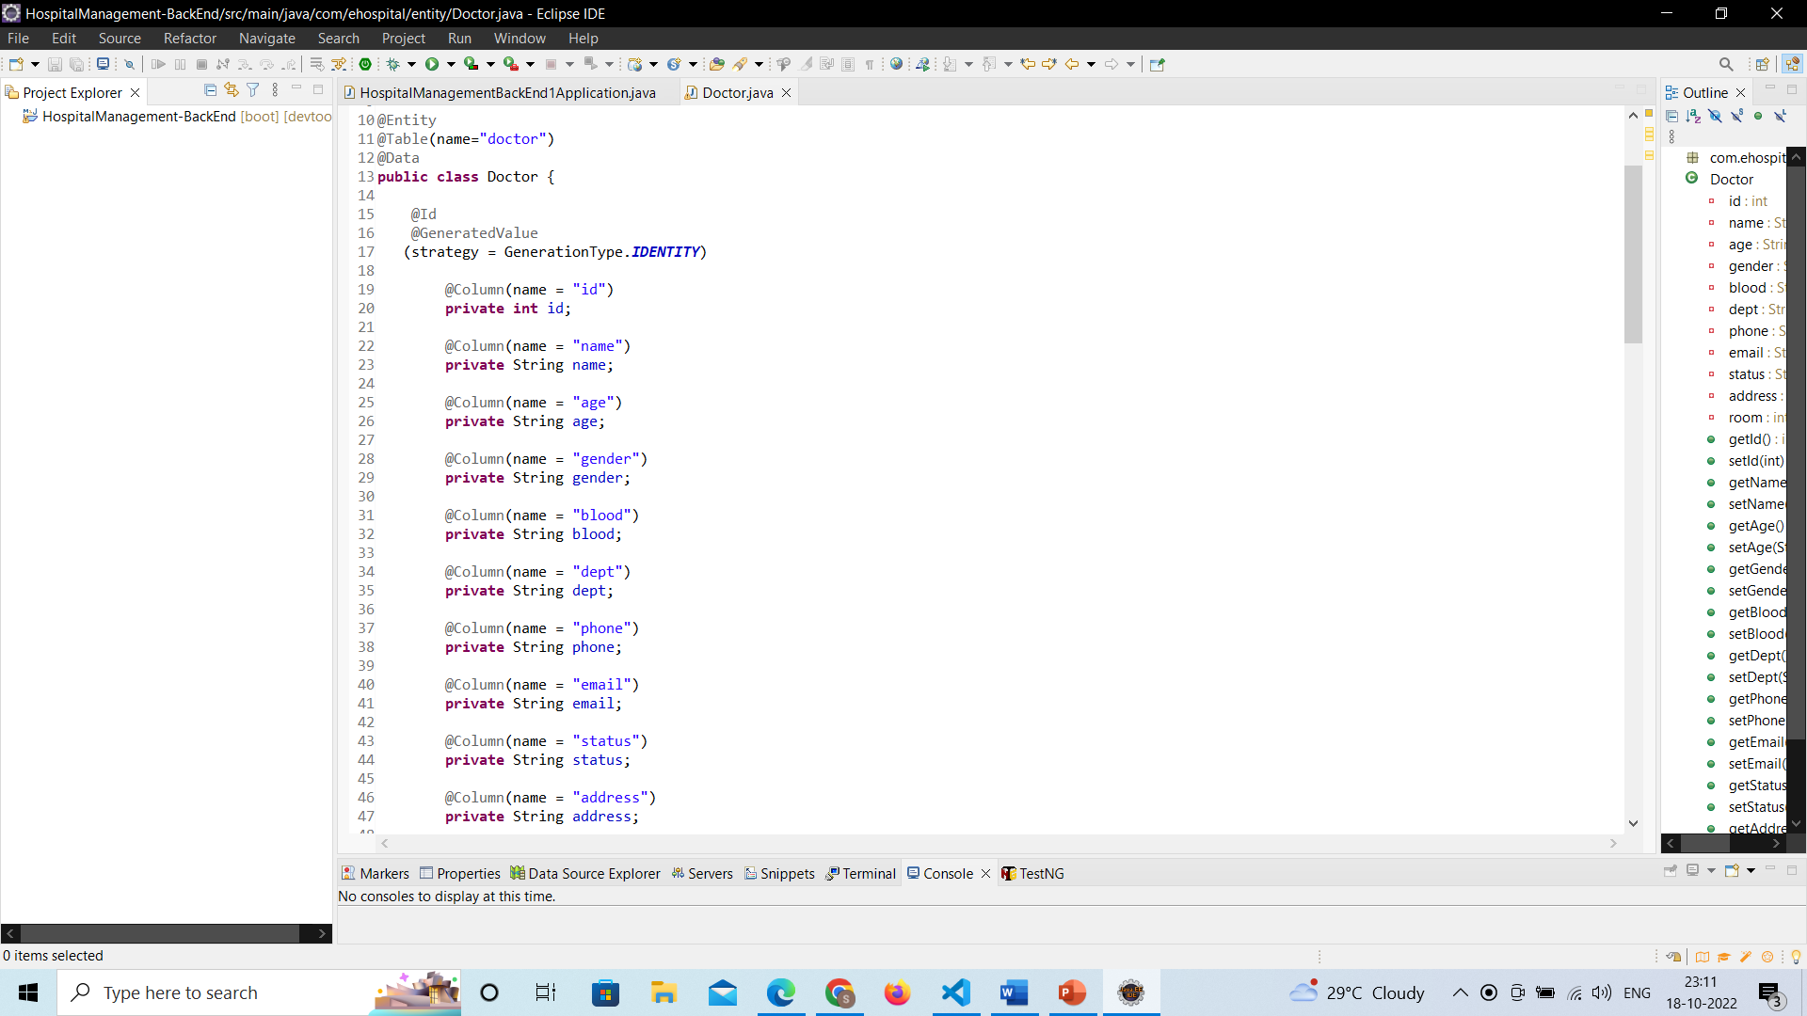
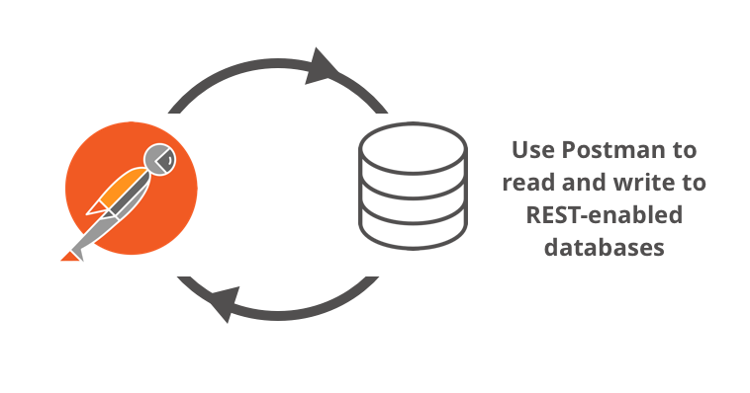
Annotations
Entity
@Entity
@Table
@Id
@Coloumn
@CrossOrgin

Slide 22
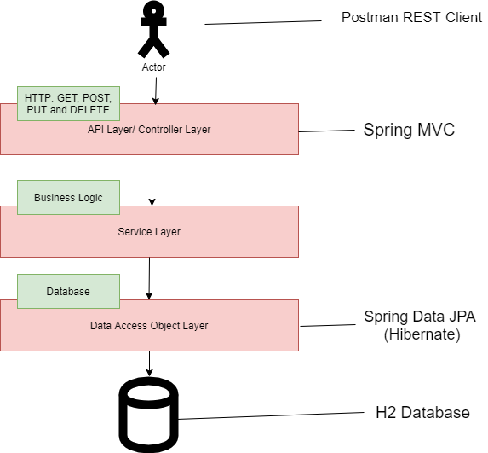
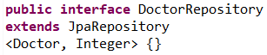
Repository
Controller
@GetMapping
@PostMapping
@PutMapping
@Delete Mapping

Slide 23
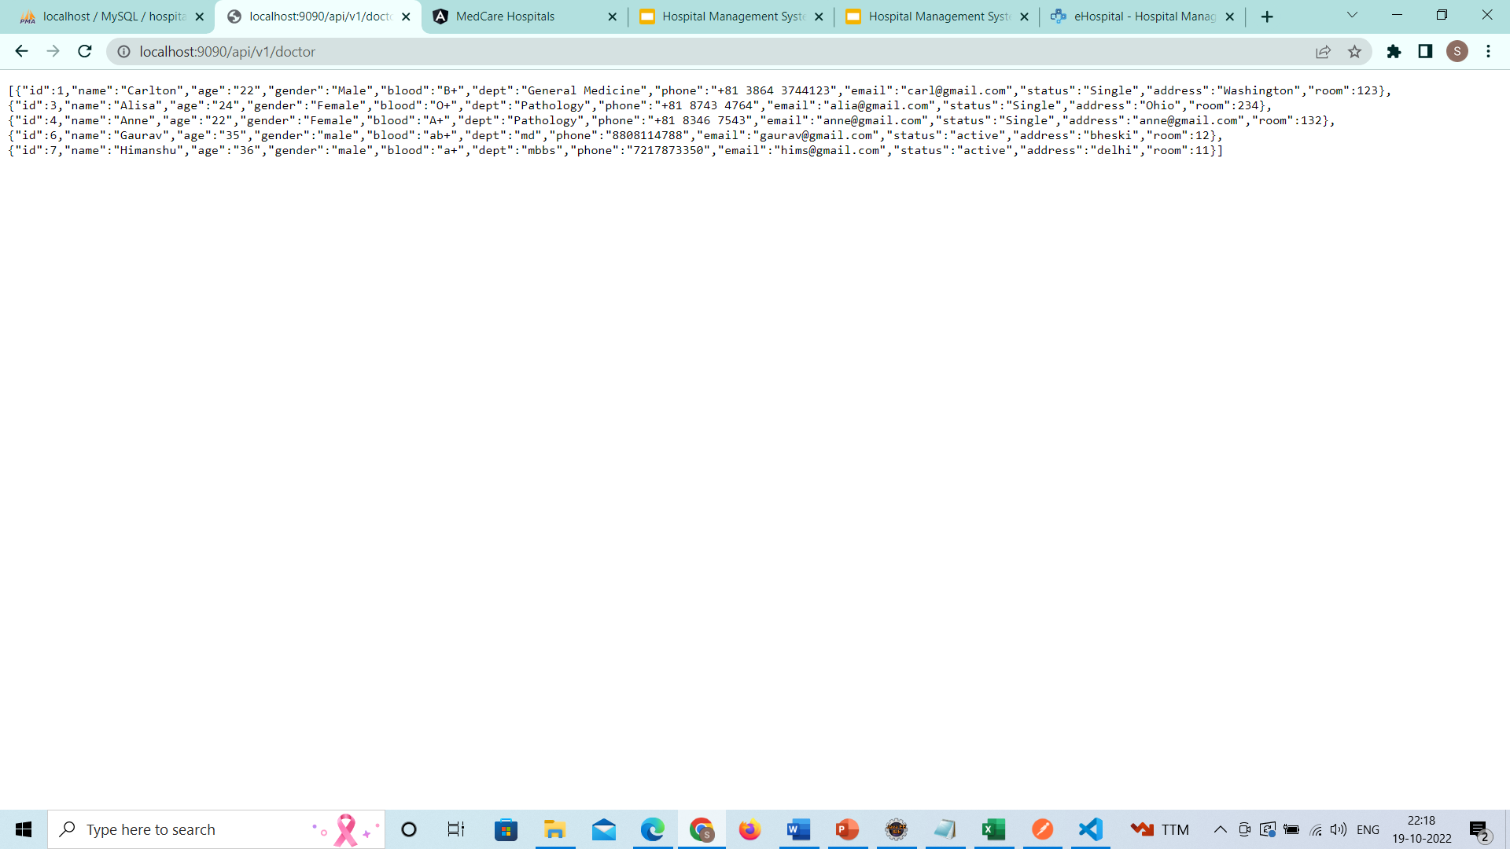
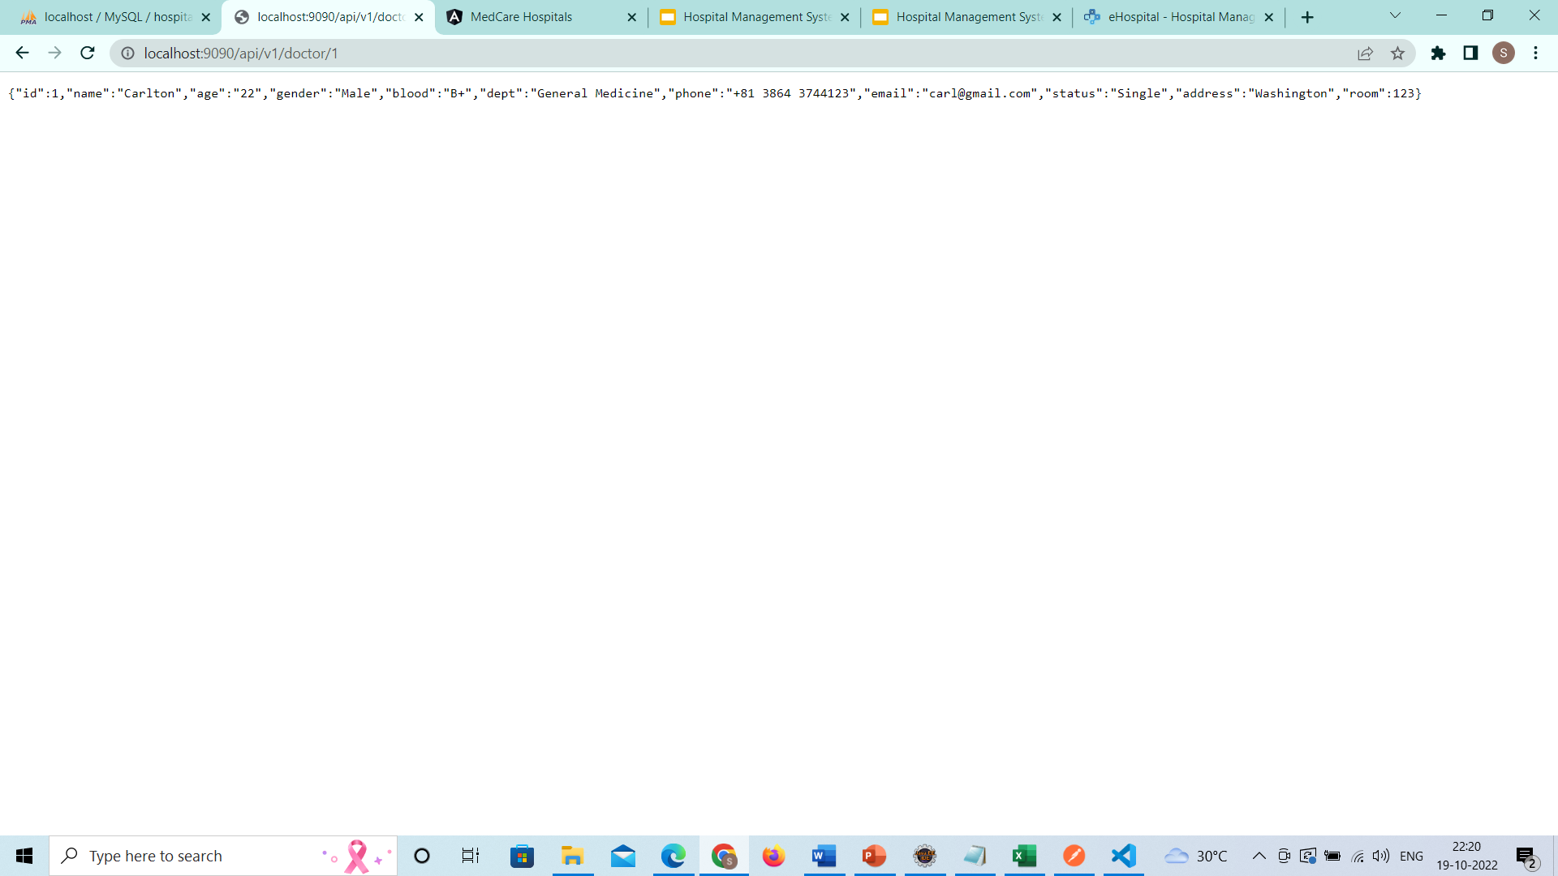
Tomcat started on port(s): 9090 (http)
http://localhost:9090/api/v1/doctor
http://localhost:9090/api/v1/doctor/1

Slide 24
Angular App Component Diagram
Create-Doctor Component
App
Doctor Component
DoctorService
Router
HttpClient
View-Doctor Component
Update-Doctor Component

Slide 25
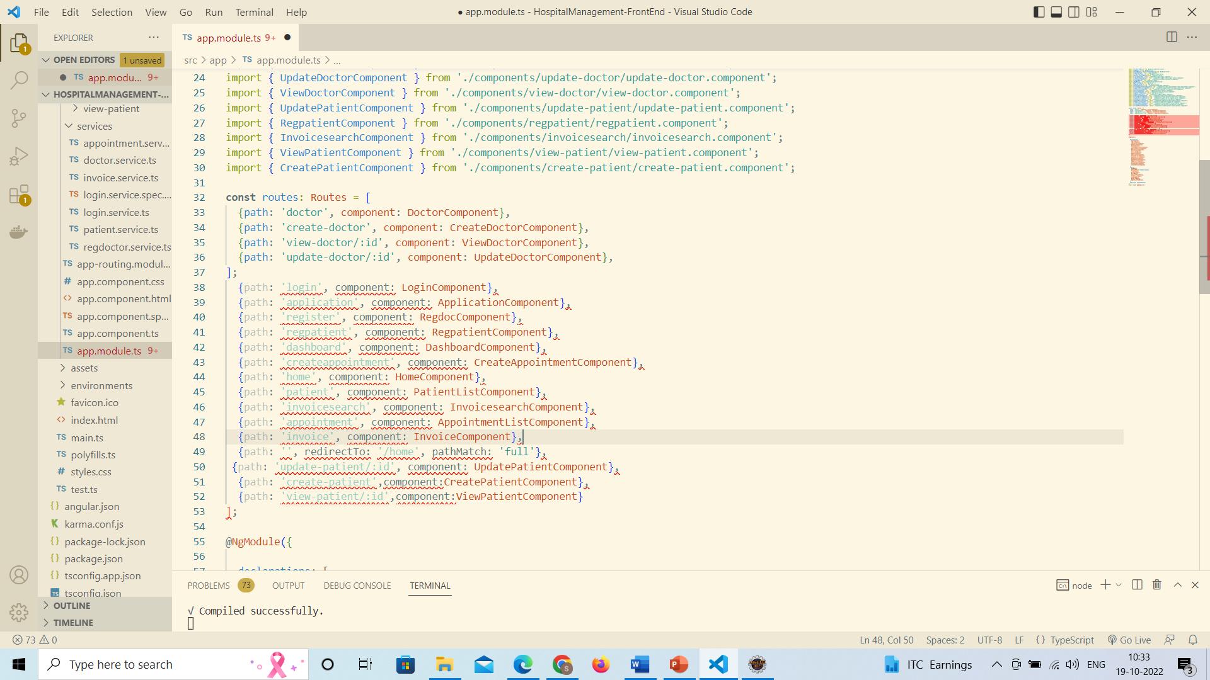
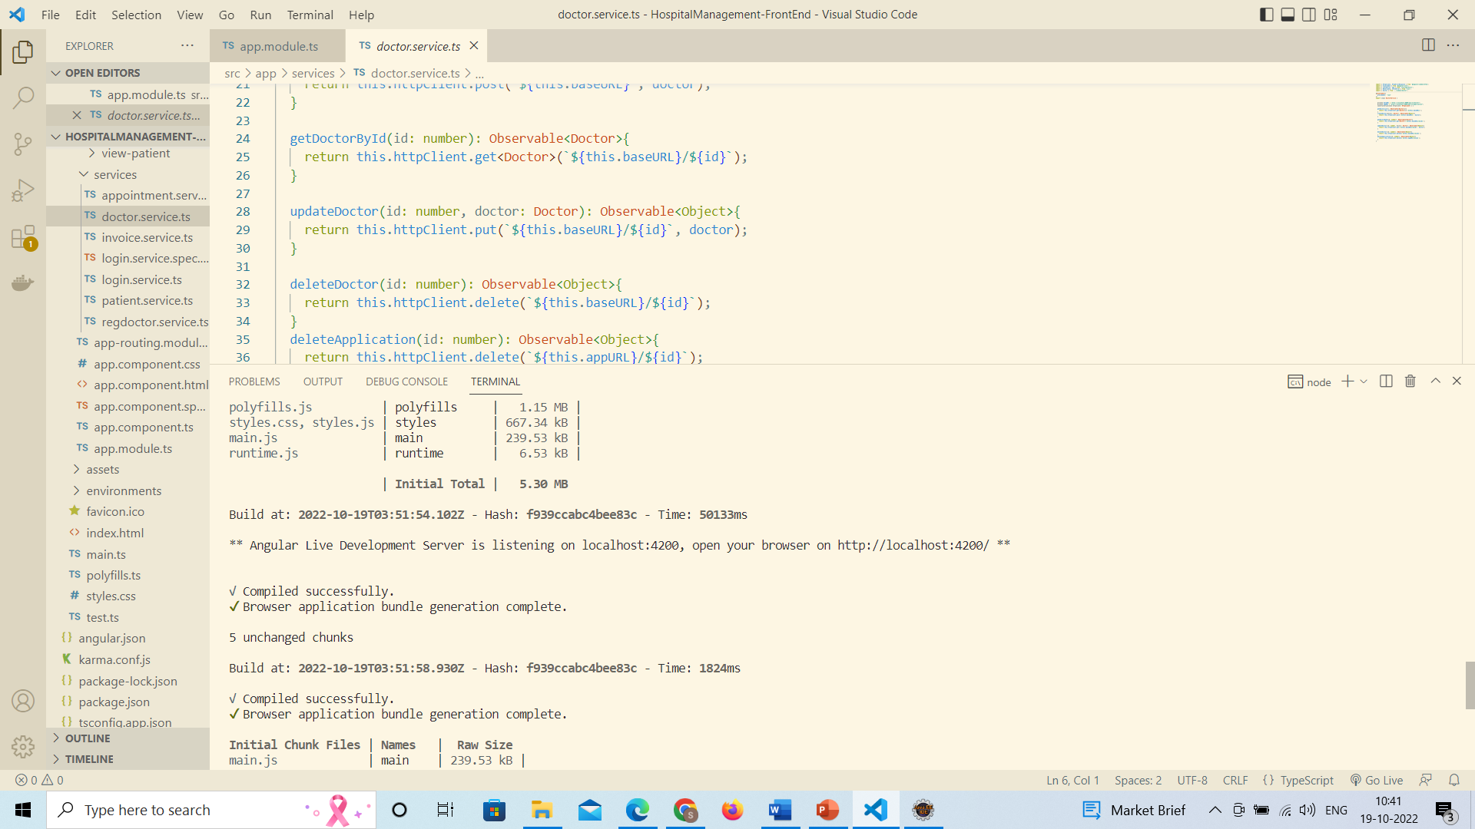
Routes
http://localhost:4200/doctor

Slide 26
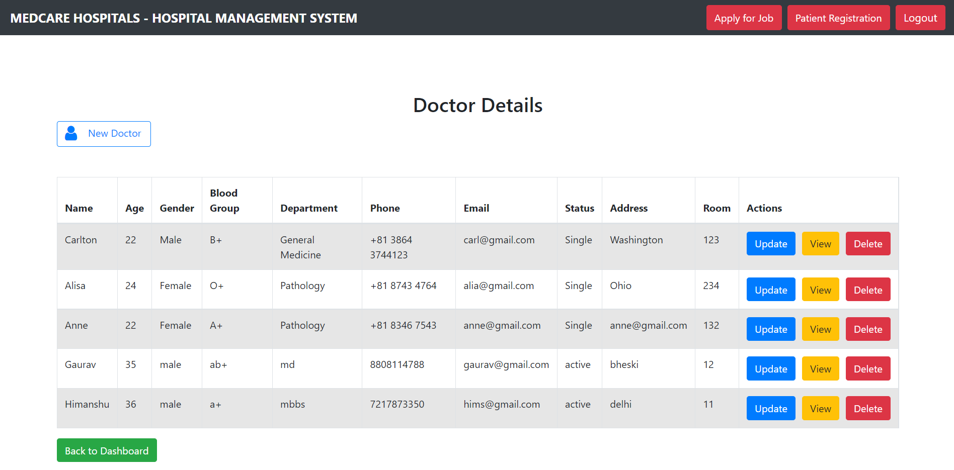
Admin Login Doctor Details Doctor CRUD

Slide 27
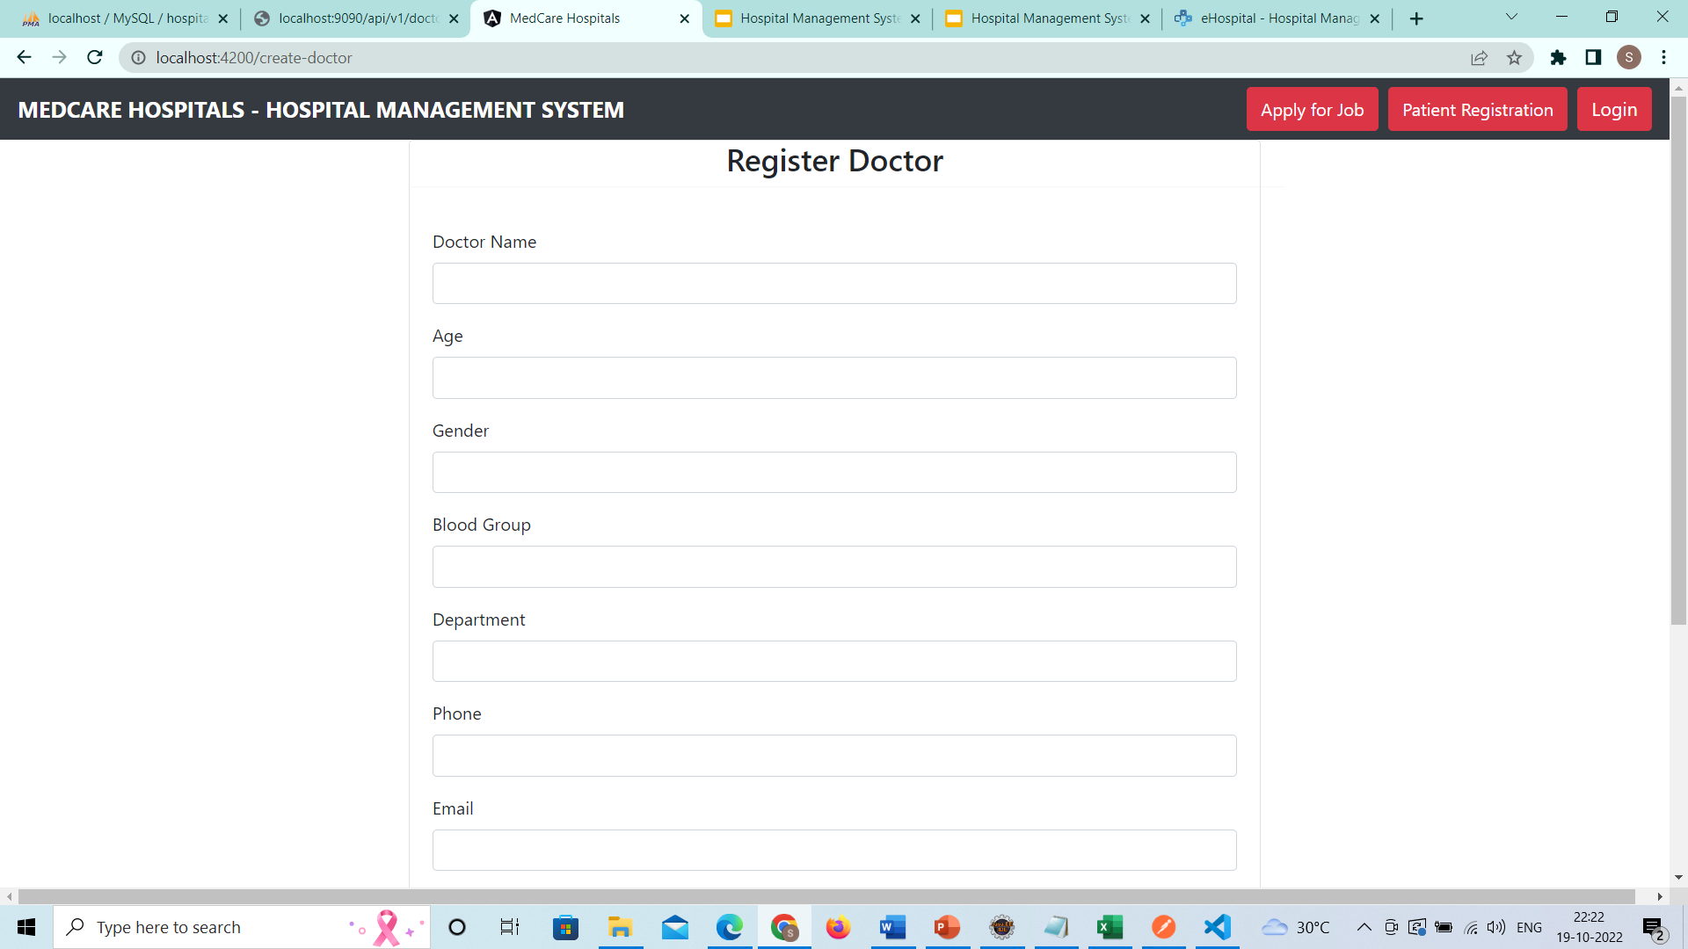
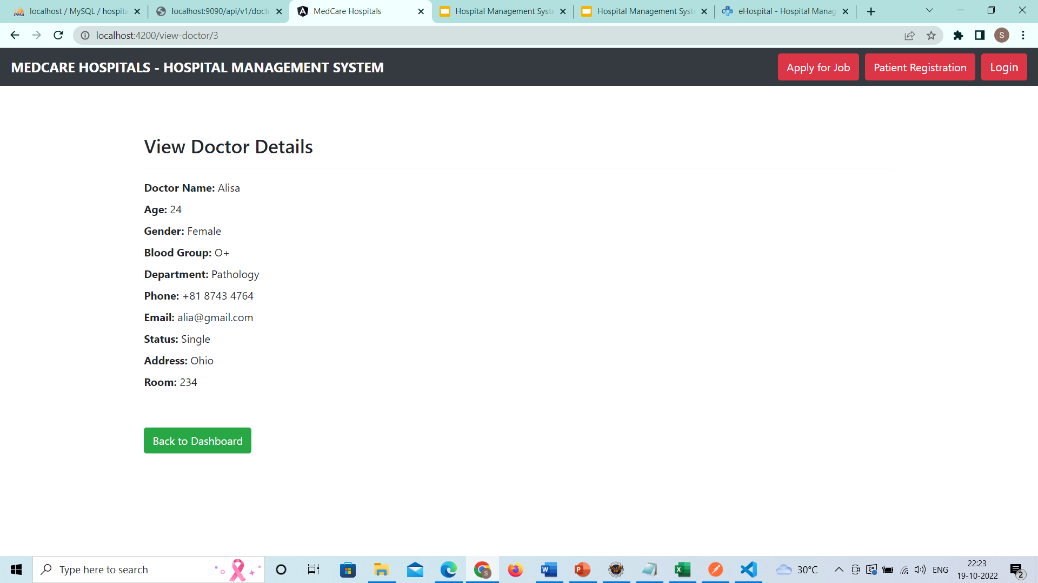
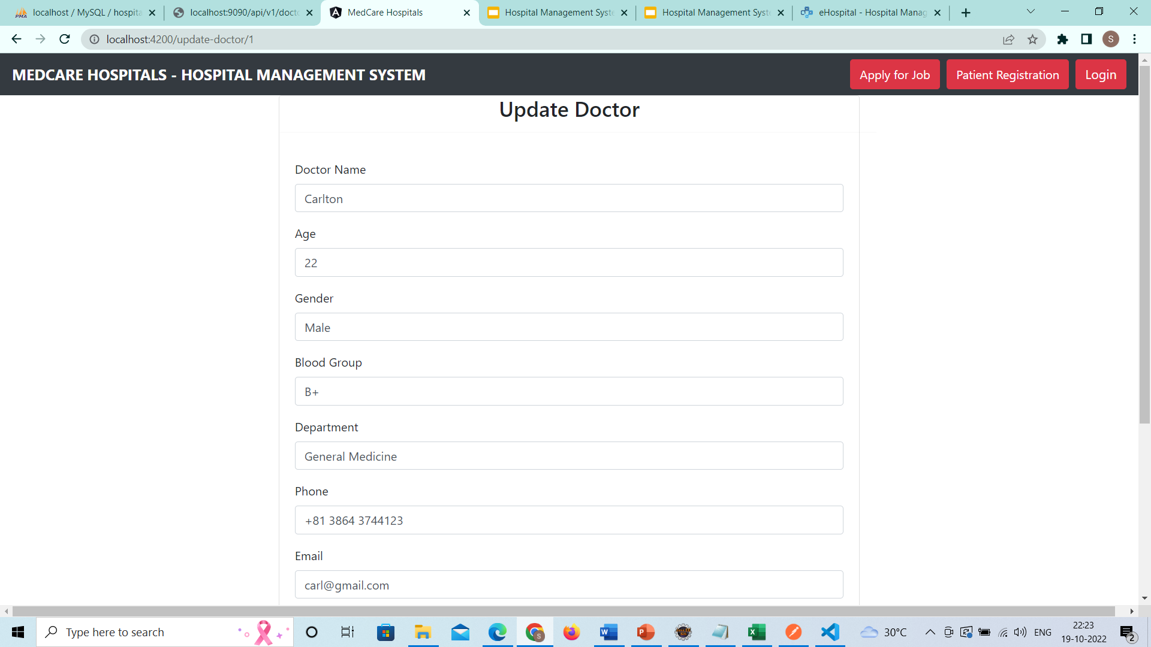
Update Doctor
Details
Register
New Doctor

Slide 28
Module 4
Patient CRUD

Slide 29
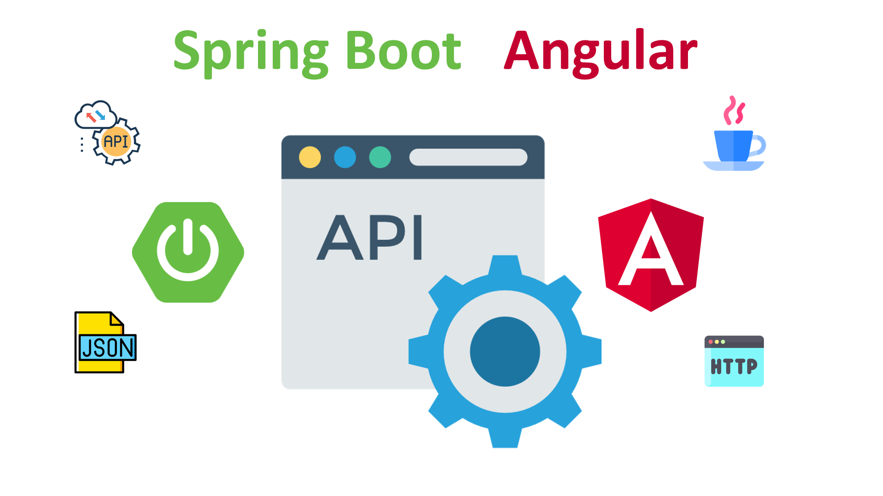


Module 4: Patient CRUD Operations

Slide 30
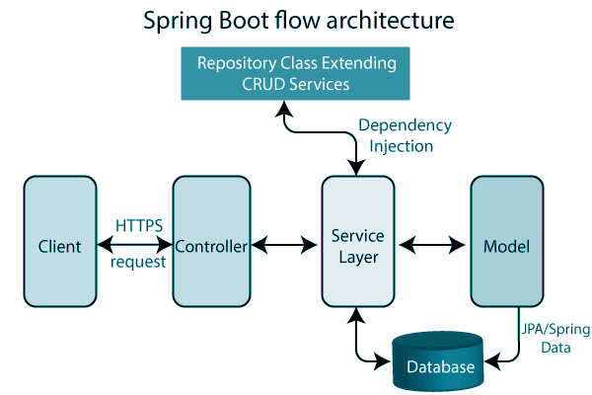
Spring Boot Architecture

Slide 31
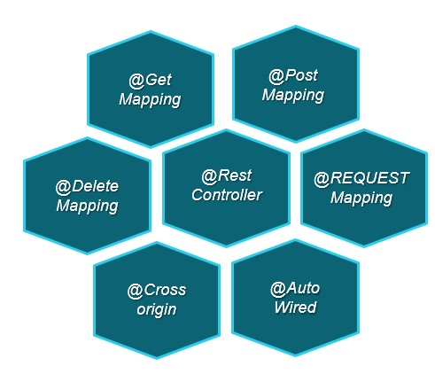
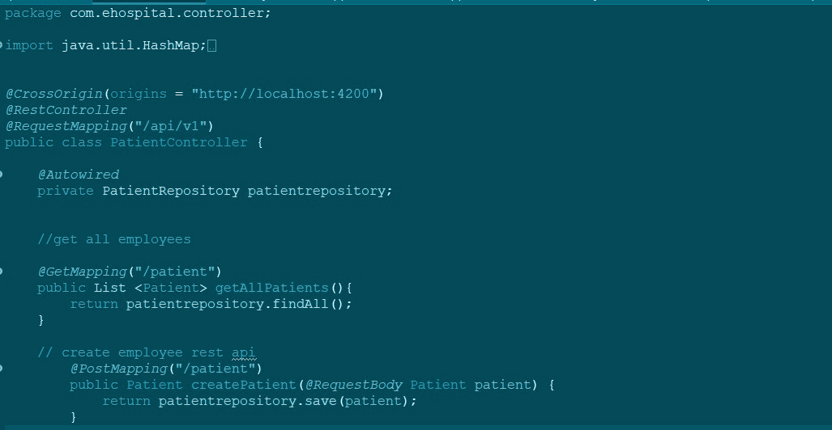
Controller Layer
The presentation layer consists of Views. the front-end part of the application and also It handles the HTTP requests.

Slide 32
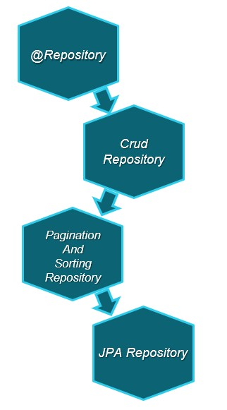
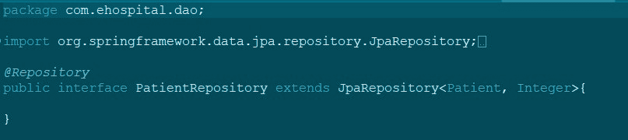
Service Layer
A service layer is a layer in an application that facilitates communication between the controller and the persistence layer.

Slide 33
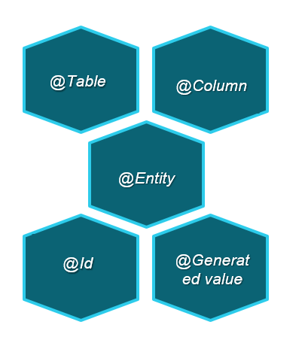
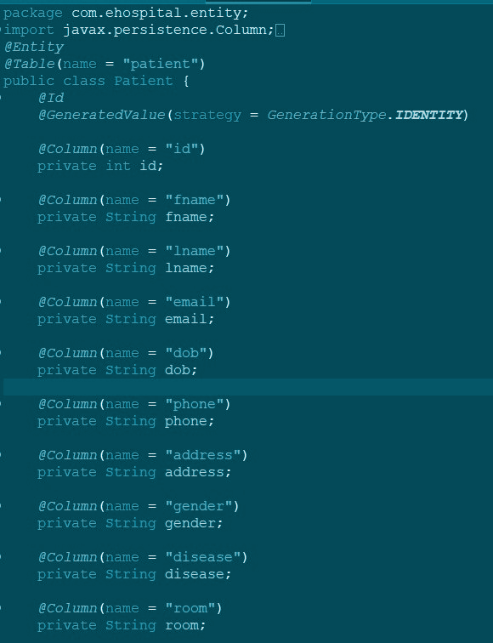
Model Layer
The persistence layer contains all the storage logic and translates business objects from and to database rows.

Slide 34

Backend output

Slide 35

Angular Architecture

Slide 36

App Component Daigram For CRUD

Slide 37


Angular Routes
To handle the navigation from one view to the next, you use the Angular Router

Slide 38


Admin Patient Details Patient Crud

Slide 39



Patient Crud

Slide 40
Module 5
Invoice Backend

Slide 41

Invoice Entity

Slide 42
Invoice Repository
By extending from the Spring JpaRepository, we have some methods for our data repository implemented, including findAll(),findById(id).

Slide 43



Invoice Controller
http://localhost:9090/api/v1/invoice
Get all invoices
Get invoice by id

Slide 44

Tomcat started on port(s): 9090 (http) with context path''
localhost:9090/api/v1/invoice
localhost:9090/api/v1/invoice/1

Slide 45
Module 6
Invoice Frontend

Slide 46

Admin Login Dashboard Invoice details
Localhost:4200/dashboard

Slide 47



Viewing Invoice Details
Invoice html
Get response

Slide 48


Patient Login dashboard Invoice details
Search by Id

Slide 49

Search by Id Viewing Invoice details

Slide 50
Module 7
Booking Appointments & Appointment List

Slide 51

LOGIN as Patient
Click “Book Appointments”

Slide 52

Booking Appointments

Slide 53

Booking Appointments

Slide 54

Doctor → Appointment Details

Slide 55

Appointment List

Slide 56

Appointment List

Slide 57
Module 8
Patient Registration

Slide 58

Go to Homepage (localhost:4200/home)
Click on Patient Registration
Click here

Slide 59



Slide 60


After clicking on submit the patient is registered successfully.
Click here

Slide 61

We can see the registered patient details in the patient list.

Slide 62
Module 9
Appointments Backend and JUnit Testing

Slide 63
Appointment Back-End Part

Slide 64

Appointment Entity-
@Entity; @Entity annotation specifies that the class is an entity and is mapped to a database table.
@Id annotation specifies the primary key of an entity
@Generated Value provides for the specification of generation strategies for the values of primary keys.

Slide 65


AppointmentRepository-
JPA Repository has full API CrudRepository and Paging And Sorting Repository.
Jpa Repository contains the APIs for basic CRUD operations, the APIS for pagination, and the APIs for sorting.
Dependency of JPA Repository
Where,
Appointment-Entity/Class Model
Integer- wrapper class of your @Id that is created inside the Entity/Model class
Method Used: -findAll(),findById()

Slide 66



AppointmentController
@RestController-RestController is used for making restful web services with the help of the @RestController annotation.
The RestController allows to handle all REST APIs such asGET,POST,DELETE,PUT requests.
@RequestMapping- It is used to map web requests onto specific handler classes and/or handler methods.
@GetMapping-It maps the HTTP GET requests on the specific handler method. It is used to create a web service endpoint that fetches.
@DeleteMapping-@DeleteMapping: It maps the HTTP DELETE requests on the specific handler method. It is used to create a web service endpoint that deletes

Slide 67


Tomcat started on port(s): 9090
http://localhost:9090/api/v1/appointment
http://localhost:9090/api/v1/appointment/1

Slide 68

Admin Appointment View
Click on Appointment Details

Slide 69

Admin Appointment View
Click On Delete and delete data

Slide 70

Doctor Appointment View
Click On Appointment Details

Slide 71

Doctor Appointment View
Click on Attended then data will be deleted from database

Slide 72
JUnit Test Case

Slide 73


JUnit Test Case For Inserting And Update Data
Insert Data Test
Update Data Test

Slide 74

JUnit Test Case Output

Slide 75

JUnit All Test Case

Slide 76

Testing Add Data Using Postman

Slide 77

Testing Get the data from Database

Slide 78
Module 10
Appointments Frontend

Slide 79

Go To Admin Login:Appointment Details
localhost:4200/dashboard

Slide 80

Appointment list

Slide 81


